Slide 1
Quantum – Custom Steps

Slide 2
Agenda
Assignment Review
Introducing Custom Steps
Writing a custom step
Steps & Utils
Assignment
Notes:
In today’s session we will be looking at custom steps.
Custom steps are at the heart of Quantum and enable you to write your own steps in Java and then call the step from the BDD script.
Writing custom steps requires familiarity with Java.
Many teams are mixed with some users experienced in Java and focusing on custom steps and others working on the BDD & object repository.
This module assumes prior knowledge of Java by at least some of the team members.

Slide 3
1. Assignment Review

Slide 4
2. Custom Steps

Slide 5
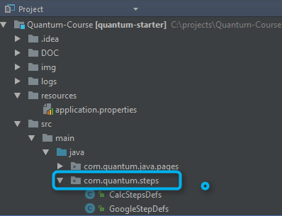
Introducing Custom Steps
A custom step is a Java implementation of a logical step
E.g. I Login to Application
Custom steps can be added and then called from the feature files
Custom steps are the recommended way to work with Quantum.
Notes:
Our test cases will have a lot of steps that repeat themselves frequently. Logging in, going to the account page, making a purchase etc. all of these examples are a series of clicks and events on the device which can be wrapped by a single step definition and then re-used.

Slide 6
Viewing a Custom Step
See the steps package in the project
View the Contacts Sample
Notes:
The steps are a Java class with a public method per step.
Each step has it's BDD name and then inside it the logic implementation to execute.
In this example, we have abstracted the differences between the platforms inside the steps and implemented for both iOS and Android.
Note in the sample the method name that is the step name, the use of standard programming logic and the references to the Utils class.

Slide 7
Creating a Custom Step
Create a new Class
Extend the WebDriverTestBase class
Add @QAFTestStepProvider flag
Write your first step method
Notes:
Review how these steps were implemented in the Contacts steps class.

Slide 8
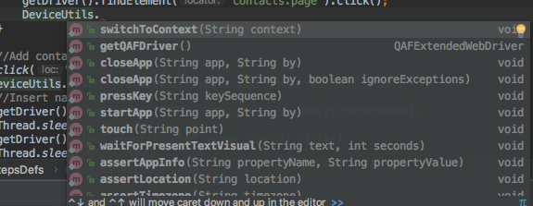
Custom Steps Resources
Quantum provides resources for custom steps
Device Utils
Common Steps
Webdriver driver
Full Java abilities
Notes:
You can write anything you want in a custom step as you are using standard Java. Logic, if statements, loops, private methods and literally everything you need is available.
Quantum also provides a series of pre-built methods you can use, these methods all run some Perfecto command. You can write the same yourself or make tweaks if you need, but in many cases the resources will save you some valuable typing time.
Go into the 3 items listed and show how to refer to them and use them.
We will be delving into the Quantum utils classes in more depth in later modules.

Slide 9
Locators in Custom Steps
you can refer locator-key in your java code for creating a web-element for example:
Java Code:
QAFWebElement txtUserName = new QAFExtendedWebElement("login.username.txt");
In Page Class
@FindBy(locator = "login.username.txt")
private QAFWebElement txtUserName;
BDD
assert 'login.username.txt' is present
sendKeys 'myusername' into 'login.username.txt'
Notes:
You can see here a few advanced options for referring to locators in the code. Find the method which best suits you.
Using @FindBy
@FindBy(locator = "<Element Locator>")
@FindBy(locator = "css=<css locator>")
@FindBy(locator = "xpath=<xpath locator>")
@FindBy(locator = "id=<element id>")
@FindBy(locator = "name=<element name>")
@FindBy(locator = "link=<link text>")
@FindBy(locator = "partialLink=<partial link text>")
@FindBy(locator = "className=<class name>")
@FindBy(locator = "tagName=<tagName>")
@FindBy(locator = "<attribute-name>=<attribute-value>")
@FindBy(locator = "key=<property that holds actual locator>")
@FindBy(locator = "property that holds actual locator")

Slide 10
3. Writing a custom step

Slide 11
Hands on
Complete the contacts flow
Check if contact exists before creating
Delete contact at end of test
Implement for both iOS & Android

Slide 12
5. Assignment

Slide 13
3. Steps & Utils

Slide 14
Steps & Utils
As we create steps we will across common actions we need to perform time and again.
We can write them once, in a designated Utils class and refer to them when needed.
This is our own extension of the helper classed provided by Quantum.
View the Utils class in the sample project and how it is used in the Contacts sample.

Slide 15
Assignment
Complete the Contacts flow for both Android & iOS.
Take the code from the training course repo and add the steps that check if a contact exists and if so delete it.
Notes:
The assignment is to take what we have done in the hands on session and complete it for both platforms.
Remember that you may need to branch your code as the applications could have slightly different flows, check this out on as device from each platform.
Our ultimate goal is a flow that adds a contact, but does not create duplicate contacts.

Slide 16
Resources
GitHub - https://github.com/Project-Quantum
Function Reference - http://developers.perfectomobile.com/display/PD/Function+Reference

